Slide 1

Creating
Add-Ons for Optimizely
CMS 12
Mark Stott (OMVP)

Slide 2
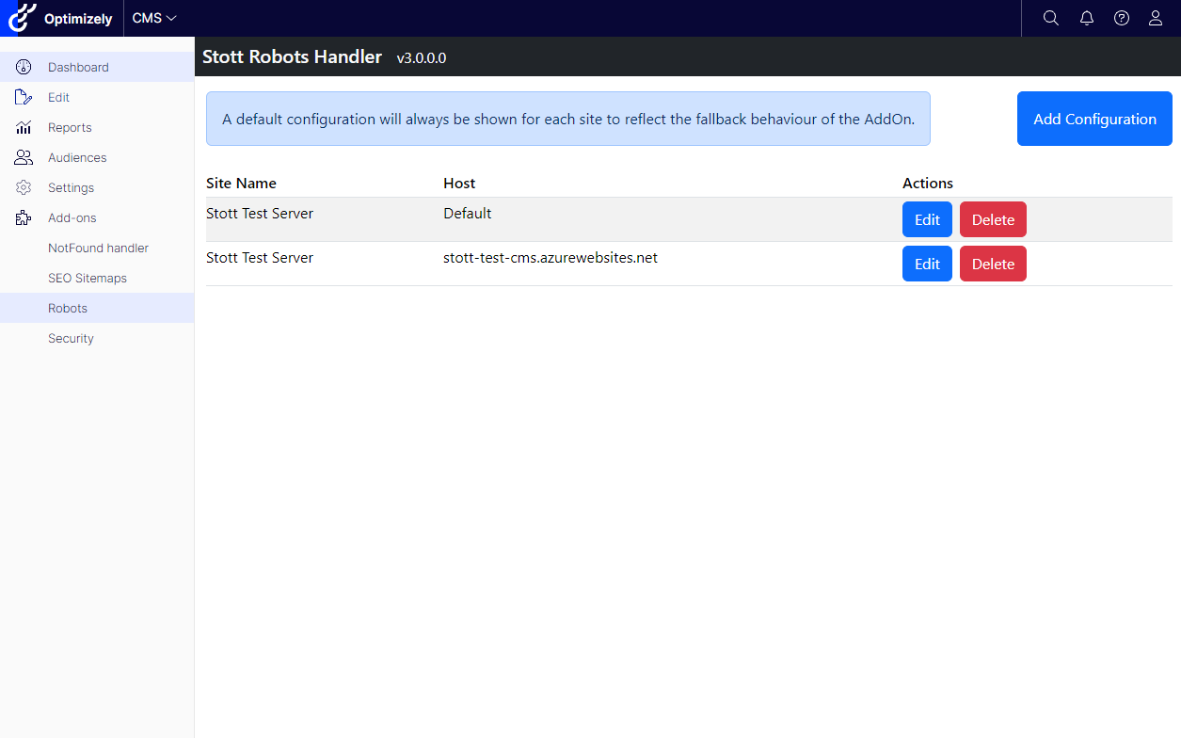
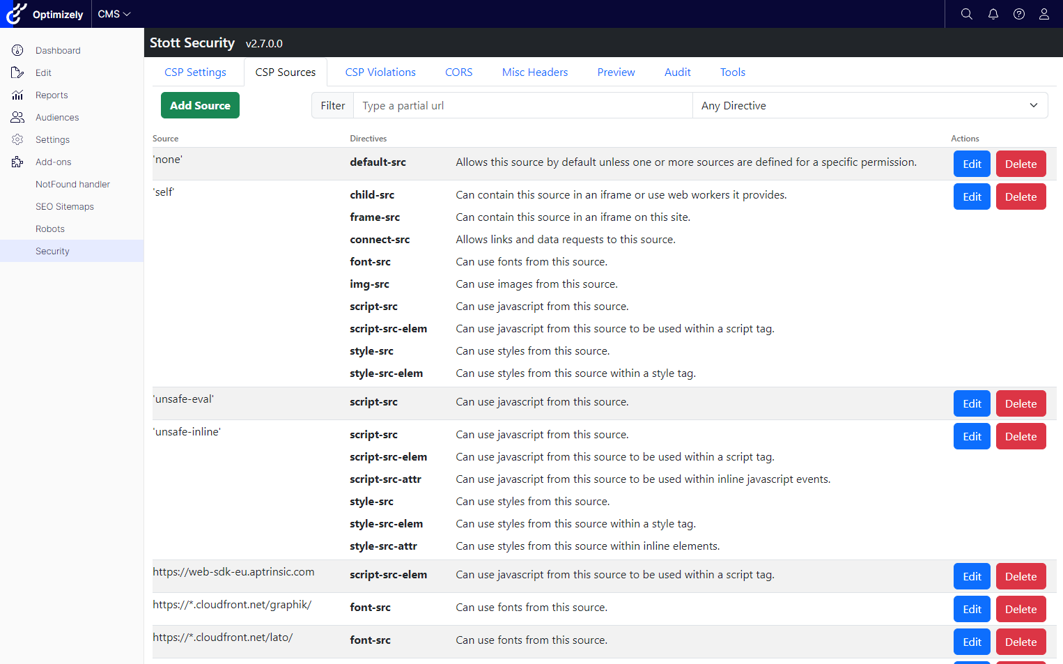
Who am I?
Solution Architect at Netcel
Platinum OMVP for 2 years
Author of: Stott Robots Handler
Author of: Stott Security
Great at agonizing over naming things

Slide 3



Agenda
Having a Great Idea
Solution Structure
Hooking into Menus
Creating Gadgets
Packaging for NuGet
Submission Process

Slide 4

Having a Great Idea
It doesn’t have to be great
It doesn’t have to be original
It doesn’t need to be pretty
It does need to be functional
You do need to be passionate about it
  It’s going to consume a lot of your time
  Stott Robots Handler has 140 commits (or 19 Days)
  Stott Security has 577 commits (or 77 Days)
  You might not make a single penny

Slide 5
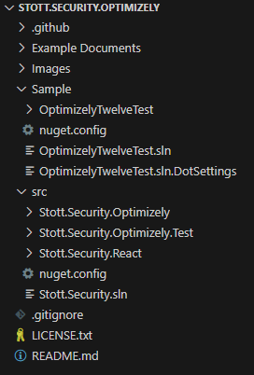
Solution Structure
Your main project file should be a Razor Class Library (RCL)
  .NET Core introduced Razor Class Libraries
  This allows you to package all your blazor / razor files as part of your compiled DLL.
Place your UI build in a separate folder if you’re using a framework such as React.
Include a separate Sample project which is a full Optimizely CMS so you can develop against it.

Slide 6
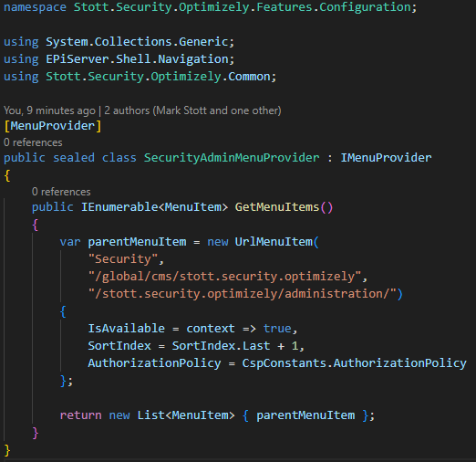
Hooking into Menus
In order to hook into the menus, all you need to do is create a class that:
  Implements IMenuProvider
  Decorated with [MenuProvider]
The parameters you’ll pass into the UrlMenuItem are:
  The name of the link within the menu
  The path within the menu system:
    /global/ places you in the module selector
    /global/cms/ places you in the Add-ons menu

Slide 7
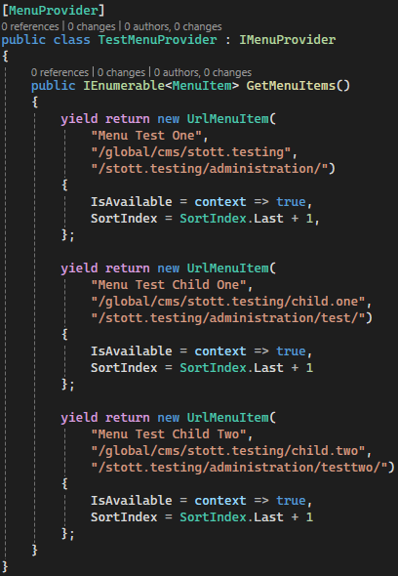
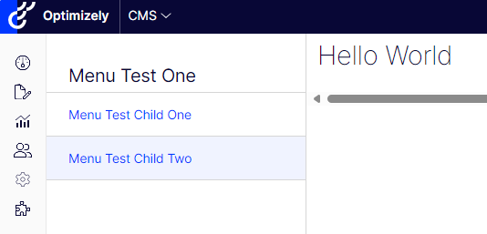
Child Menus
To set a child menu you simply need return additional menus with nested paths:
Parent: /global/cms/stott.testing/
Child: /global/cms/stott.testing/child.one/
Optimizely will render the menu hierarchy and highlight the associated menu item for the page you are on

Slide 8
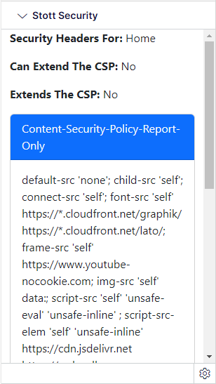
Adding a Gadget
Creating a gadget is trickier because you have multiple tasks in order to make it work:
Create a new MVC Controller to provide a route and UI for the Gadget
Tell the CMS about assembly the gadget is in a module.config
Tell the CMS about the module.config in a service configure method

Slide 9
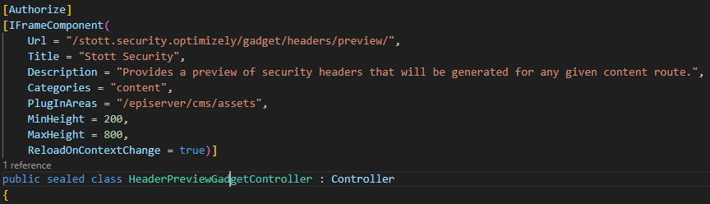
Adding a Gadget
Create a standard MVC Controller and decorate it with the [IFrameComponent] attribute.
The Title and Description will be shown in the Add Gadgets interface.
ReloadOnContextChange will trigger a reload of your gadget every time you change which content item you’re looking at.
  The Version specific Id of the content is passed into the query string as ‘id’ e.g. id=123_45

Slide 10
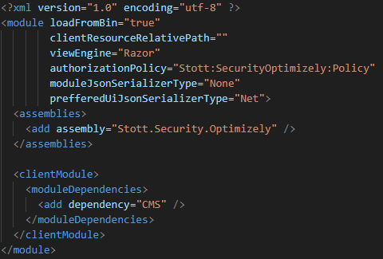
Adding a Gadget
For the CMS interface to understand which assembly the Gadget is in you must add a module.config file.
This could be the module.config file in the route of your website.
But if you’re packaging for NuGet, then this will want to be deployed on the following path to make this easier for other developers:
  <website>/modules/_protected/<module_name>/module.config
There is some extra fun making NuGet packages and ensuring that they place this here.

Slide 11
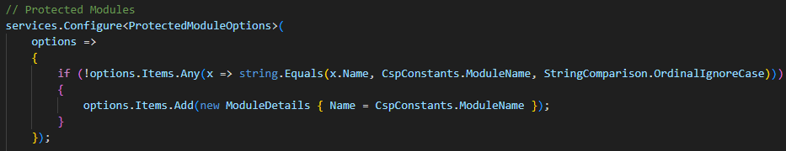
Adding a Gadget
For the CMS to recognize that you have added a new folder under /modules/_protected/ you need to tell the application it exists
This is done by calling Configure on ProtectedModuleOptions during the startup of your site.
Best practice is to wrap this up in a ServiceExtensions method so that consumers of your package don’t have to configure everything manually.

Slide 12
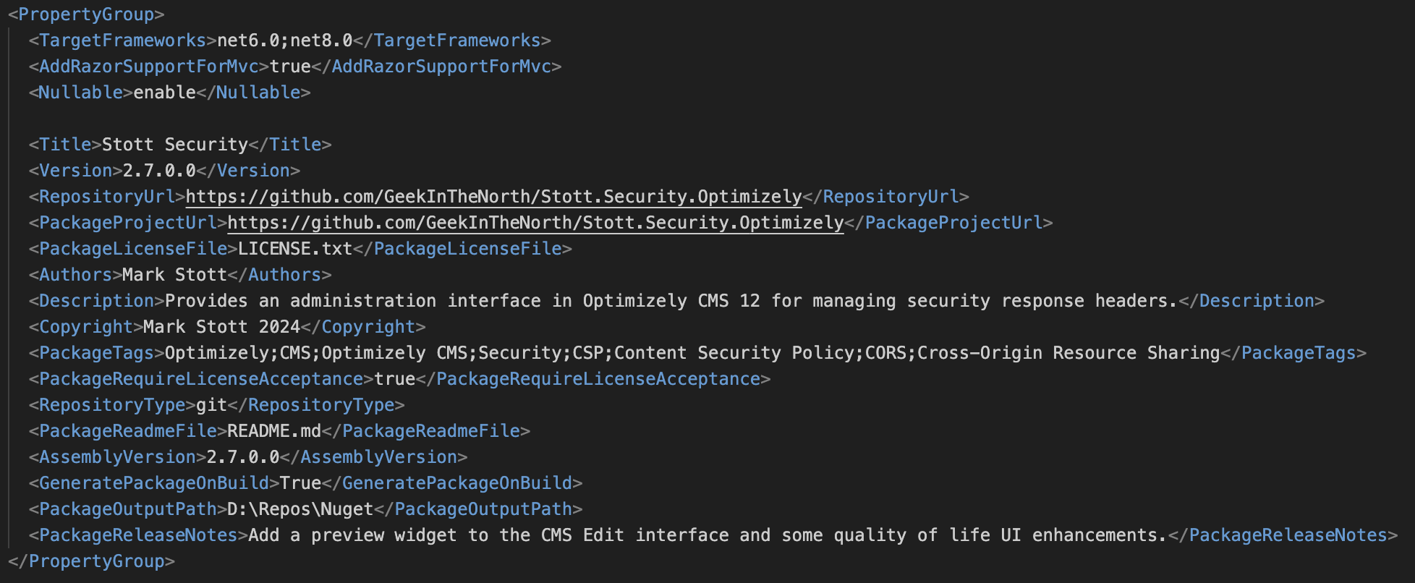
Packaging for NuGet
If you set your package information through the project properties window in visual studio, then NuGet package information is added straight to your csproj.
Then just right click your project in Visual Studio and tell it to Pack.

Slide 13
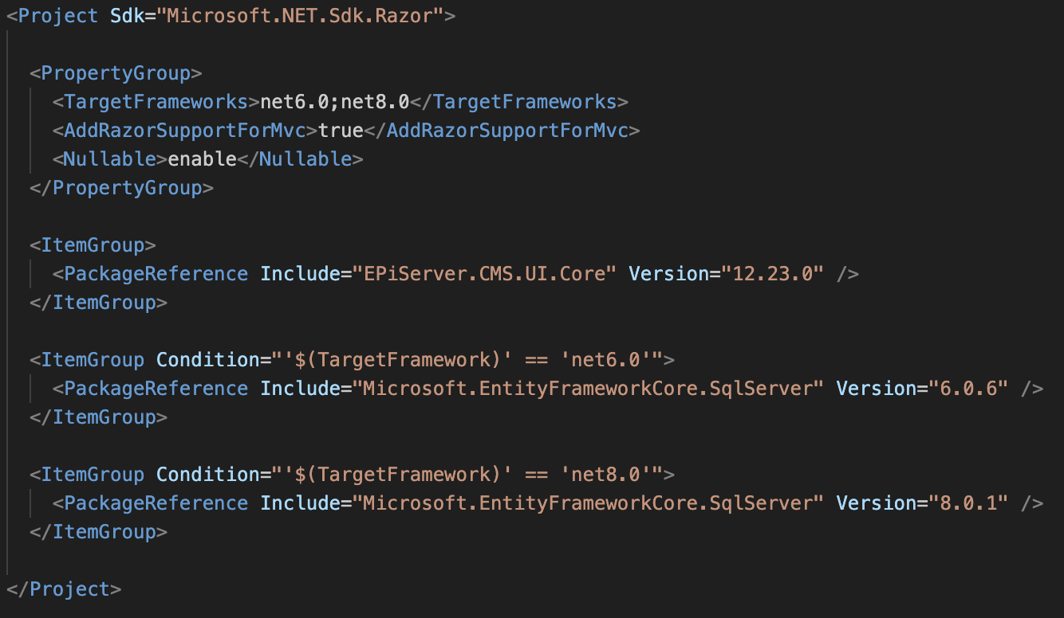
Packaging for Multiple Frameworks
If your package uses Entity Framework, then you will need to target multiple .NET versions
  This is due to differences with migrations between .NET6 and .NET8
Simply change TargetFramework to TargetFrameworks at the top of your project and comma separate the frameworks.
Add conditions to your ItemGroups to set the version of your dependencies based on framework

Slide 14
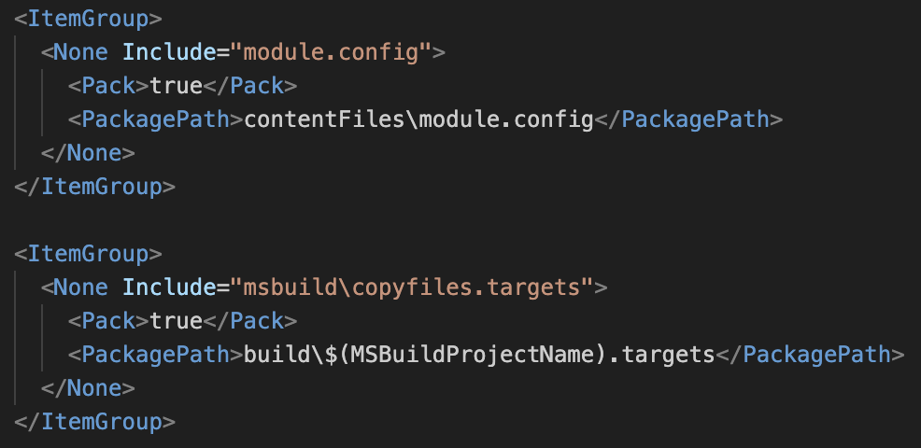
Packaging Protected Modules Files
This includes anything under /modules/_protected/ e.g.
  modules.config
  JavaScript
  Stylesheets
Include them in the project:
  Set the build output to None
  Set Pack to true
  Set the PackagPath to place them in contentFiles
Include a build targets file

Slide 15
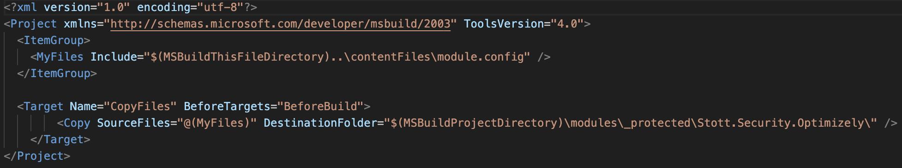
Packaging Protected Modules Files
The build targets file is responsible for performing extra actions such as copying files from the NuGet package to a specific folder.
This uses a number of variables for folder names:
$(MSBuildThisFileDirectory) is the folder where the build targets file exists within the NuGet Package.
$(MSBuildProjectDirectory) is the folder of the project we are installing into.

Slide 16
Submitting Your Package
Create an account on https://www.nuget.org
  Use this to submit all your alpha / beta builds so you can test installing them locally or in a CI/CD pipeline
When you’re ready to go live:
  Login to https://nuget.optimizely.com with your Optimizely World account
  Upload your package
  Wait for Optimizely to approve your package, this can take time
There is a current issue right now with submissions to https://api.nuget.optimizely.com where packages are not being sync’d back to https://nuget.optimizely.com, but the sync works in the other direction.
You can also have your Add-On listed on the Marketplace, you can reach out to Simon Chapman for the latest form links

Slide 17


Thank You
Mark Stott
@GeekInTheNorth
https://geekinthenorth.github.io
https://www.linkedin.com/in/mark-antony-stott/

