Slide 1

Creating Reusable PowerShell scripts to deploy through the DXP environment

Slide 2


WHO AM I?
Eric Markson
Senior Technical Consultant
Perficient
Blog: www.epivisuals.dev
Eric.Markson@Perficient.com
eric@ericmarkson.com

Slide 3

INTRO TO THE DEPLOYMENT API

Slide 4
What is the Deployment API?
The Deployment API is actually a REST API that runs a series of workbooks to do some tasks.
This REST API has been wrapped up into a Powershell module that can be used by anyone.
Deployment
  Fetch/Upload file to a specific URL
  Deploy from file location or from environment
    Deployments up and down of code
Content Sync
  Databases and/or BLOBS can be synchronized up or down
Export
  As of Update 313, Databases can be exported as BACPAC file

Slide 5

WORKFLOW FOR DEPLOYING THROUGH DXP ENVIRONMENT

Slide 6
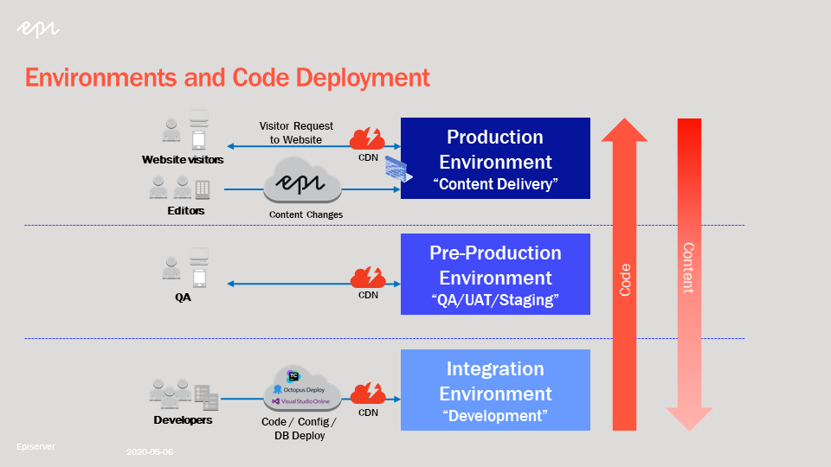
DXP Deployment Workflow

Slide 7

AZURE DEVOPS DEPLOYMENT WORKFLOW

Slide 8
Azure DevOps Pipeline Workflow

Slide 9

BUILDING A PIPELINE AND DEPLOYMENT FILE

Slide 10
Creation of the Pipeline
When we use the Azure DevOps Pipeline (Formally called a “Build” in TFS/VSTS), we’re going to be doing a few things:
  Build the Solution
  Package the Solution into the proper format and structure
    <app name>.<package type>.app.<version>.nupkg
    Example: alloyexample.cms.app.1.0.0.0.nupkg
  Move the file into the output Artifact location

Slide 11
Demo of Pipeline Creation

Slide 12

BUILDING THE SCRIPTS

Slide 13
Building the PowerShell Scripts
These are the EpiCloud commands that exist:
  Connect-EpiCloud
  Get-EpiDeploymentPackageLocation
  Add-EpiDeploymentPackage
  Start-EpiDeployment
  Get-EpiDeployment
  Complete-EpiDeployment
  Reset-EpiDeployment
  Start-EpiDatabaseExport
  Get-EpiDatabaseExport
There are 6 actions that we are going to look at:
  Get and Upload a package to a provided location
  Deploy to environment from package location
  Deploy to environment from environment
  Complete or Reset an in-progress deployment
  Export Database

Slide 14
Demo of Scripts

Slide 15

RELEASE PIPELINE + CI/CI TRIGGERS

Slide 16
Creation of the Release Pipeline
When we use the Azure DevOps Release Pipeline, were going to bring together everything that we’ve seen previously. The steps are the following:
  Set up the Variable Group
    Keys generated from PAAS Portal
  Set up the Artifacts
    Get the NUPKG file
    Get the Github repo for the Powershell Scripts
      (Fork if necessary)
    Set up the Continuous Deployment Trigger on the artifact
  Create the Upload package stage
  Create the Deploy to Integration from Package
  Create the Complete Stage, with prior approval gate
  Create the Reset Stage, if we don’t like how the release looks

Slide 17
Demo of Release Creation

Slide 18

PROMOTE TO ENVIRONMENT & SYNC DOWN

Slide 19
Promote Up vs. Sync Down
Promoting Upward and Syncing Downward are pretty much the same exact action, but one simply goes “with the grain” and the other goes against it.
The proper deployment flow has always been going from Integration, to PreProduction, and to Production. (This functionality has been available in the PAAS portal for a while)
The promotion process largely focuses around code being pushed upwards, but absolutely can include blobs/database.
As of 4/27/2020, Update 313 brought the capability to Sync Downward in environments. This will allow you to make sure the content can be the same across your environments (without having to engage support).
The sync down process largely focuses on blobs/database (content) bring brought down, but can include code, if needed.

Slide 20
DXP Deployment Workflow

Slide 21
Demo of Promotion & Sync Down

Slide 22

Questions?

Slide 23
Resources + Info
Powershell Script Github Repo: https://github.com/ericmarkson/EpiCloud-Scripts/
  Please feel free to fork this repo, so you can add it into your Pipeline/Release by reference
  Also feel free to put in pull requests for updates (or request updates to me)
EpiCloud Powershell Module: https://www.powershellgallery.com/packages/EpiCloud/
My Blog – Epi Visuals: https://www.epivisuals.dev/
Perficient EpiServer Blog: https://blogs.perficient.com/episerver/
Epi World Blogs: https://world.episerver.com/blogs/
Contact: eric.Markson@Perficient.com or eric@ericmarkson.com

Slide 24

Thank you

